Slide 1
GameCheck:
A Video Game Information Site
Team 9
MIE350 – Design and Analysis of Information Systems
November 18, 2019

Slide 2
Presentation Outline
What is GameCheck? Why is it needed?
How does GameCheck work?
What has the team learned so far?
Conclusion

Slide 3
1. Background
What is GameCheck? Why is a website needed?

Slide 4

What is GameCheck?
Gaming store chain with 5 stores in the GTA
Sells physical copies of games for consoles & accessories

Slide 5

Why is a Website Needed?
Sales have declined in recent years
There continues to be high demand for physical copies of games [1]
The team was tasked to develop a way to inform potential customers of their products

Slide 6
2. How does the Website Work?
Overview of the Web Application

Slide 7



What does the Website Do?
Visitors can…
Find specific video games and accessories using customized filters
Retrieve information about games and accessories for each location
Evaluate specific games and accessories

Slide 8
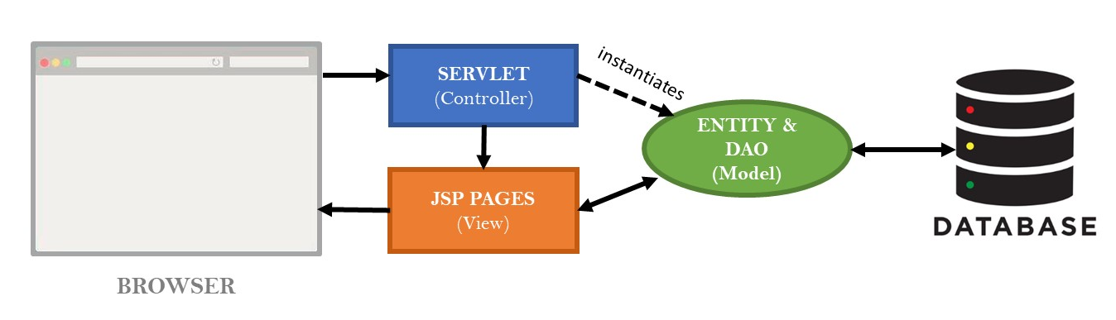
System Architecture
Notes:
The system architecture of the website follows the Model-View-Controller (MVC) design pattern, which specifies that the website has three main components: Data Model, Presentation Information (View), and Control Information [5]. The three components interact both directly and indirectly with the website’s database.

Slide 9


What Goes on Behind the Scenes?
Game of Interest Information Page
Video Games Database
Game of Interest
Customer Search Specification
Find Items
UPC Number
Review Content
Email Address
Rating
Customer Rating Review Database
Review
Rating
Customer
Evaluate an Item
Information Link
Purchase Link
Console Database
Console Name
Retrieve Item Details

Slide 10
What Has the Team Done So Far?
Project Plan Established
Server Implementation
and Progress
Report
Integration and
QA Testing
Roles and sub-teams assigned to each member
Major technical and design milestones were established and agreed upon
Functional and non-functional requirements listed
Database and webpages created
Established simple server connection
Server connections and webpages are finalized
Test cases for each function are drafted and executed

Slide 11
What Has the Team Done So Far?
Project Plan Established
Server Implementation
and Progress
Report
Integration and
QA Testing
Roles and sub-teams assigned to each member
Major technical and design milestones were established and agreed upon
Functional and non-functional requirements listed
Database and webpages created
Established simple server connection
Server connections and webpages are finalized
Test cases for each function are drafted and executed

Slide 12
What Has the Team Done So Far?
Project Plan Established
Server Implementation
and Progress
Report
Integration and
QA Testing
Roles and sub-teams assigned to each member
Major technical and design milestones were established and agreed upon
Functional and non-functional requirements listed
Database and webpages created
Established simple server connection
Server connections and webpages are finalized
Test cases for each function are drafted and executed

Slide 13
3. What has the team learned?
Project Challenges and Resolutions

Slide 14

Project Challenges
Lack of communication between project team and teaching team
Lack of communication between front-end and back-end teams
Lack of common knowledge regarding key website concepts

Slide 15


Project Resolutions
Project team will proactively clarify unclear items with teaching team
Team calendar will be created where tasks and deadlines are clearly defined
Common documents regarding website components will be created for clarification

Slide 16
4. Conclusion
Key Takeaways and Next Steps

Slide 17

Key Takeaways
The team was tasked with creating a website that provides information on products
The website allows visitors to:
  Find specific items
  Retrieve item details
  Evaluate items
The team will continue working on the integration of the website

Slide 18


Next Steps
Expand video game selection to PC
Expand inventory to include video game consoles
Add option to reserve video games and accessories in-store

Slide 19
Thank You!

Slide 20
References
[1] "Why do gamers still buy physical games?", GamesIndustry.biz, 2019. [Online]. Available: https://www.gamesindustry.biz/articles/2018-09-14-why-do-gamers-still-buy-physical-games. [Accessed: 04- Nov- 2019].

Slide 21
Images
http://clipart-library.com/communication-cliparts.html

Slide 22
Q & A
Questions?

